Slide 1
Simple Mail Transfer Protocol (SMTP)
Shenandoah Valley Governor’s School
John York, Fall 2017

Slide 2
Email Basics
Email started as text-based system
Developed before evil came to the Internet, few security measures
From: and To: headers are easily spoofed
Vulnerable to spam (junk mail) and phishing (malicious mail)
Some security measures added later, not always employed
Users connect to the email system with Mail User Agents (MUA)
Example protocols are POP3 (port 110, encrypted uses 995), IMAP (143, 993), and HTTP/S (80, 443)
Mail travels between mail servers, or Mail Transfer Agents (MTA)
Commonly use SMTP (port 25, encrypted 465, 587)

Slide 3
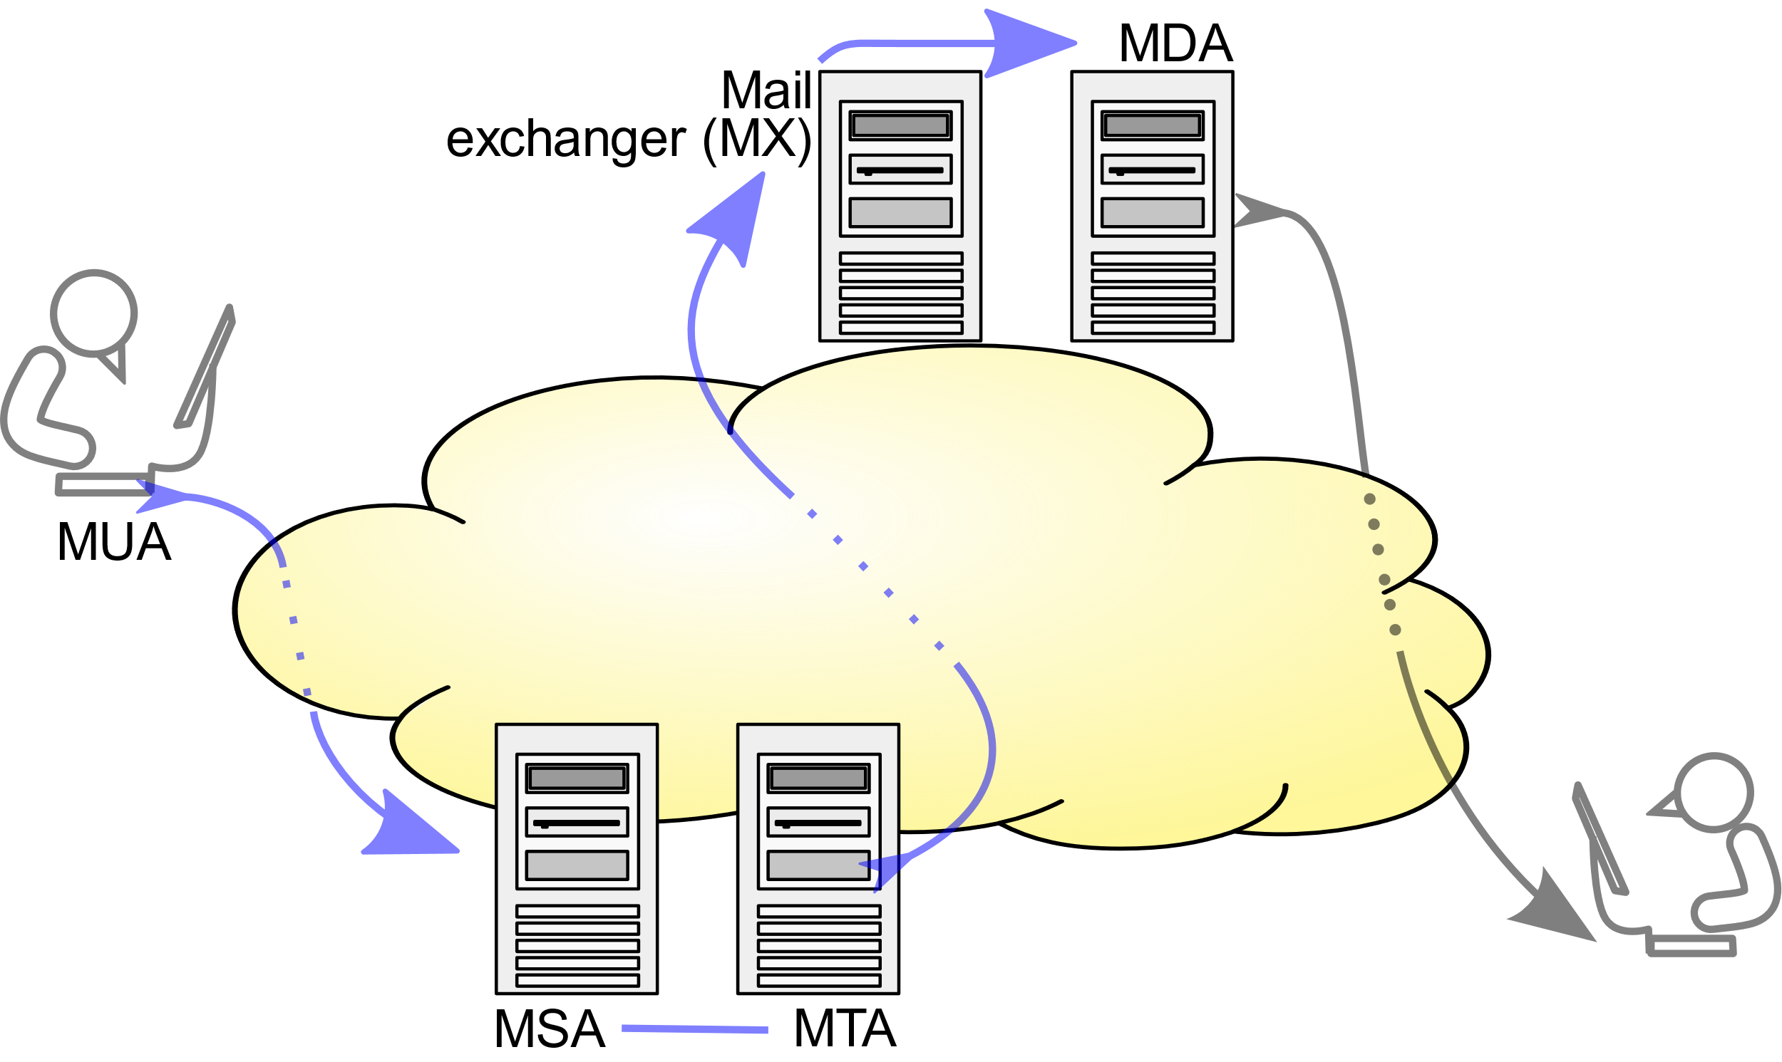
Mail Transfer Agents (MTA) and Mail User Agents (MUA)
Drawing from https://en.wikipedia.org/wiki/Simple_Mail_Transfer_Protocol

Slide 4
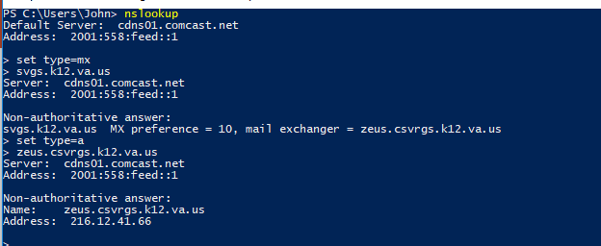
DNS MX Records
Each MTA, or SMTP server, needs a DNS MX (Mail Exchange) record so other mail servers can find it.
View MX records using dig or nslookup

Slide 5
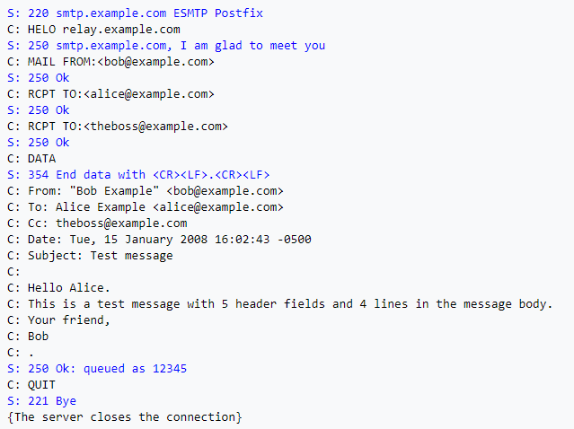
SMTP Example (blue is server, black is client)
“Envelope”
RCPT TO must be correct for delivery
Message Headers
All can be forged
Message Body
Example from https://en.wikipedia.org/wiki/Simple_Mail_Transfer_Protocol
Many servers will allow you to do this manually with telnet, netcat, or ncat to port 25

Slide 6
Email Envelope vs. Header To: and From:
Envelope portion (often) is not in message headers
Note that both the Envelope and Headers have To: and From: fields
Envelope RCPT TO: must be correct—that’s where message goes
Envelope HELO/EHELO <server name> and MAIL FROM: may be checked
Message Header To: and From: are not usually checked
Therefore To: and From: in header cannot be trusted
Spam and Phish often forge To: and From: to fool the user
So, what can we trust?

Slide 7
Information Sources
Message as shown to user
Much info can be bogus, but…
Message Body: Source
Message body often written in HTML
Not shown to user (without effort, often need to Google to find access method for each mail client)
SMTP Server Logs
Usually records envelope portion
Message Headers
Part of message, not shown to user (without effort)
Additional log and troubleshooting data included

Slide 8
Message as shown to user
Much can be forged or fake, but there are some clues
Good advice here
http://www.techrepublic.com/blog/10-things/10-tips-for-spotting-a-phishing-email/
Many phish are low quality and give themselves away
Mouse hover over link does not match message
From: address doesn’t match message content
Spelling/grammar errors, etc.
A well written phish will pass all these tests
Check other sources to make a better evaluation

Slide 9

SMTP Server Logs
Record the Envelope portion of the SMTP transaction
Not usually available to user
So, user cannot use them for spam/phish detection
Example log, one transaction from Windows SMTP server:
Part of log, enlarged. Envelope commands are recorded, headers are lumped into DATA

Slide 10
Email Message Headers
Valuable information source
Shows each MTA (mail server) the message passed through
Often shows sender’s mail client info and IP address
Shows header To:, From:, CC: as user sees them
Hard part is often getting mail client to show headers
Use search engine to find header location in your email client
Good walkthrough of using email headers here (please read)
https://www.howtogeek.com/108205/htg-explains-what-can-you-find-in-an-email-header/

Slide 11
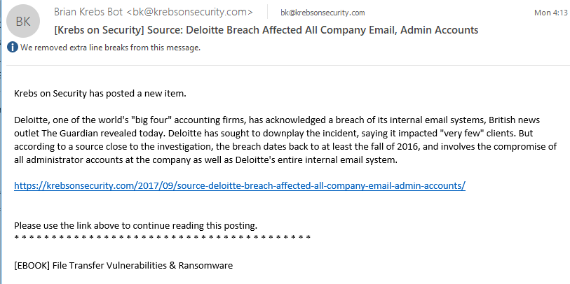
Normal Email

Slide 12
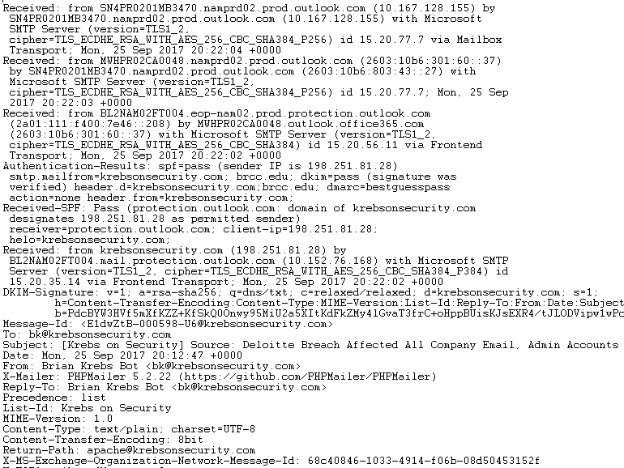
Normal Email—Header
Fourth mail server
Outlook.com
Third mail server
Outlook.com
Second mail server
Outlook.com
First mail server
krebsonsecurity.com sent to outlook.com
Sender mail client

Slide 13
Normal Email—Evaluation, first pass
Shown to user
Message makes sense
From: address matches content
Mouse hover over link matches link display
Header information
Mail client was PHPMailer 5.2.22
Sensible for a mass email system
Received from krebsonsecurity.com (198.251.81.28)
Matches message header From: bk@krebsonsecurity.com
nslookup 198.251.81.28 gives www.krebsonsecurity.com
www.arin.net lookup of IP gives FranTech Solutions, Cheyenne, WY
Probably mail/web provider—not definitive but at least is in US
More about SPF and DKIM (security items) later
So far, looks good

Slide 14
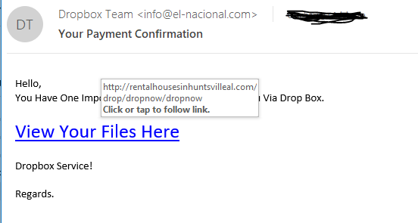
Phish email

Slide 15
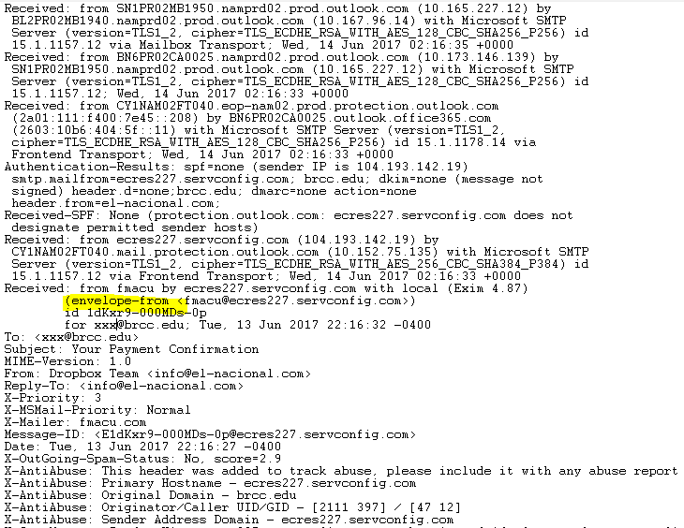
Phish Email--Header
Second mail server
servconfig.com to outlook.com
First mail server
servconfig.com
Note envelope-from
Sender mail client
fmacu.com ???

Slide 16
Phish Email—Evaluation, first pass
Shown to user
Message purports to be from Dropbox, but From: info@elnacional.com ??
Mouse hover over “View Your Files Here” goes to http://rentalhousesinhuntsvilleal.com ?? (site probably compromised)
Header information
Mail client fmacu.com?? That resolves to congreso internacional de ultrasonido (international congress of ultrasound)
Received from fmacu by servconfig.com ?? Where is Dropbox?
Phish!!

Slide 17
SMTP Security Measures
Restrict incoming messages—no open relays!
Encrypted SMTP STARTTLS
SPF Sender Policy Framework
DKIM Domain Keys Identified Mail
DMARC Domain-based Message Authentication, Reporting & Conformance

Slide 18
Restrict Incoming Messages
Open Relay (bad)
Mail server allows any host to send to any address
Mail server will be abused by spammers
Once abused, spam block lists will report server as spam source
Mail from the server IP or domain will be dropped by most servers
It takes a lot of work to get a server removed from all block lists
Solutions
Server accepts mail from the Internet
Only accept email destined for the domain serviced by the server
Local mail server, sends to Internet
Require login for mail destined for other domains, or
Block incoming Internet access to local mail server

Slide 19
STARTTLS
Encrypt SMTP to protect messages in transit
Uses same encryption (TLS) as HTTPS
Provides NO protection while email is at rest on mail server or mail client

Slide 20
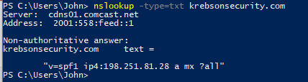
SPF Sender Policy Framework
Adds a TXT resource record to DNS
Lists the mail servers that are allowed to send from that domain
In this case, IP address 198.251.81.28
Should be, but may not be, checked by receiving mail server
Server checks the domain in the SMTP envelope, not message header
Message header “From:” may still be forged!!

Slide 21
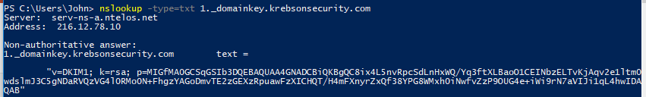
DKIM Domain Keys Identified Mail
Sending organization creates a public/private key pair
Sending server signs parts of the message with private key
Usually fields like Date, To, From, Reply To, and Subject
Message body not usually signed (use PGP or similar for that)
Public key is posted in organization’s DNS

Slide 22
DKIM does and does not…
DKIM does
Validate that the email did come from the organization
Public key is stored in organization’s DNS
Validate that the headers that were signed did not change in transit
DKIM does not
Does not verify that Envelope From: and Header From: are the same
Does not provide protection after message delivery or protect against resending altered messages (use PGP or other encryption)
Does not say anything about intent or behavior of sender

Slide 23
DMARC Domain-based Message Authentication, Reporting & Conformance
Verifies that Envelope From: and Message Header From: match
Properly configured, prevents spoofing From: so that outside mail appears to come from your own address
SPF/DKIM verify that sender is entitled to use Envelope From:, from your organization
DMARC verifies that Message Header matches
Requires that SPF and/or DKIM be already configured
Uses a DNS TXT Resource Record

Slide 24
For Best Email Security
Organization should use all three, SPF, DKIM, and DMARC
Or DMARC and SPF or DKIM, at least
Back to our Normal and Phish email header examples…

Slide 25




Normal Email—Header
DKIM passes
Public key on krebsonsecurity.com authenticates signature
DMARC
bestguesspass???
SPF passes
krebsonsecurity.com DNS says IP address is permitted to send
DKIM information

Slide 26
Normal Email—Evaluation, second pass
SPF passes
IP that sent email is listed as a sender in krebsonsecurity.com DNS
DKIM passes
Public key in krebsonsecurity.com validates the message headers signed with krebsonsecurity.com’s Private key
DMARC best guess pass??
krebsonsecurity.com does not have a DMARC record in DNS
BUT, Office365 Exchange Online Protection added it
O365 says message would have passed DMARC if it were configured
SPF and DKIM validated Envelope From:, Message Header From: matches
https://blogs.msdn.microsoft.com/tzink/2015/05/06/what-is-dmarc-bestguesspass-in-office-365/
Email is real

Slide 27



Phish Email--Header
DKIM
none
DMARC
none
SPF
none

Slide 28
Phish Email—Evaluation, second pass
SPF, DKIM, DMARC all = none
Phish!!

